Slide 1
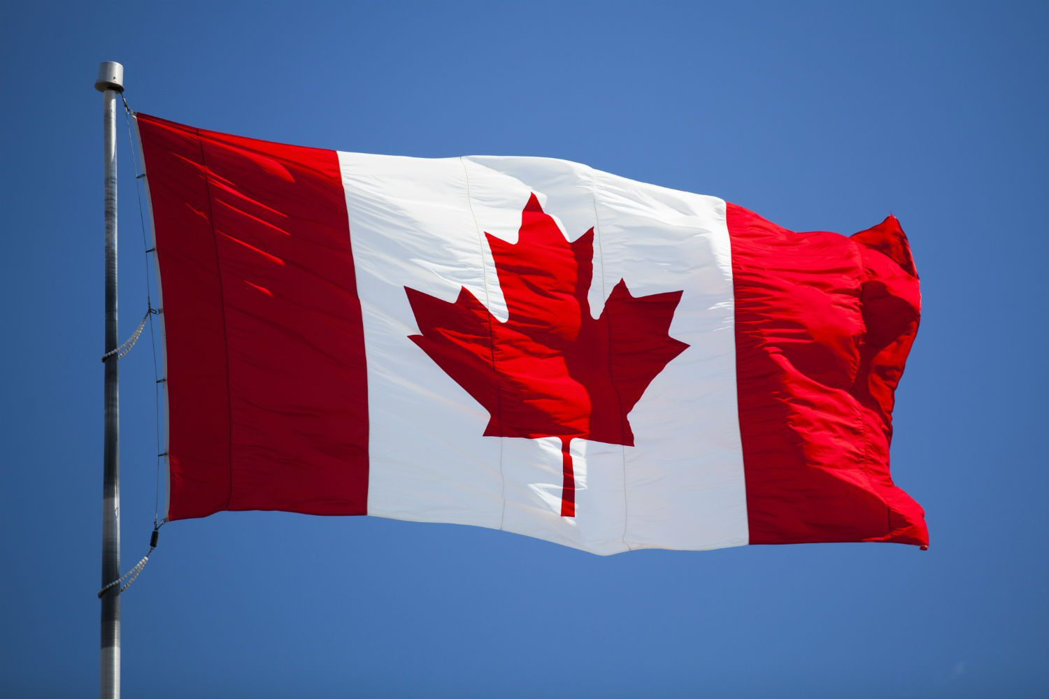
Notes:
Canadian flag

Slide 2

Notes:
Professor Oak

Slide 3
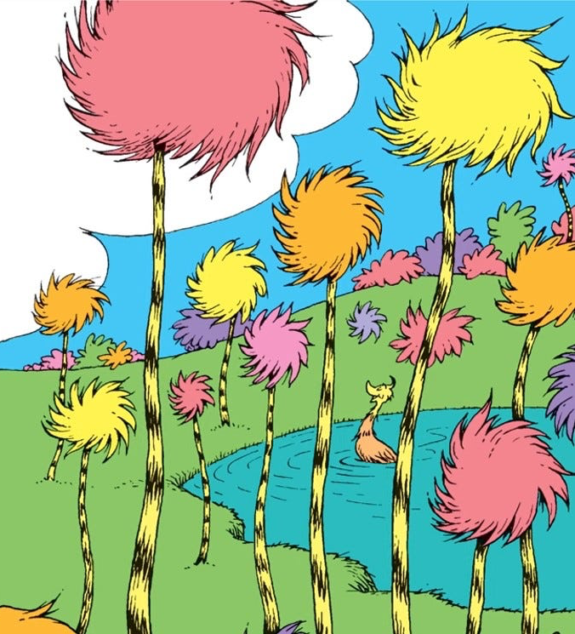
Notes:
Truffula trees

Slide 4
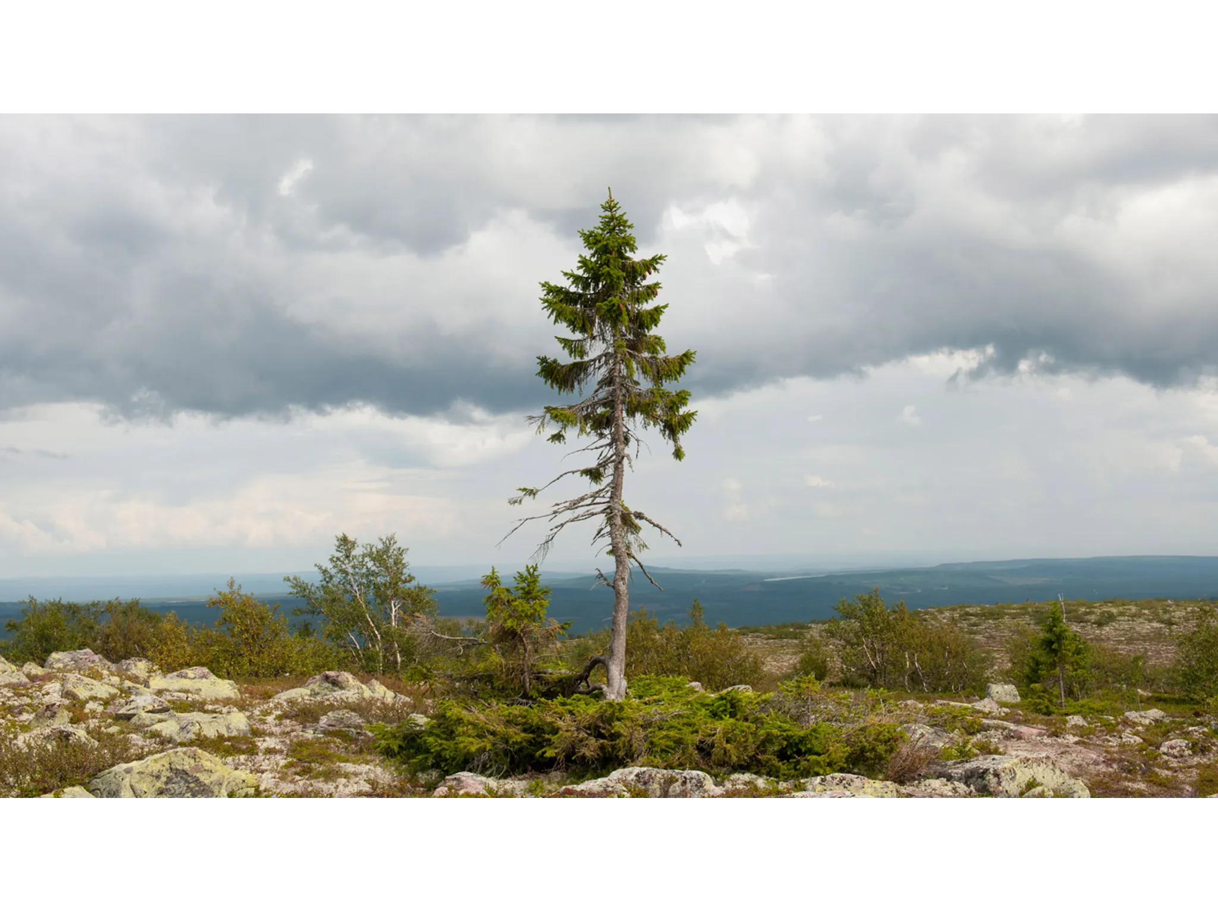
Notes:
Old Tjikko

Slide 5

Notes:
r/trees

Slide 6
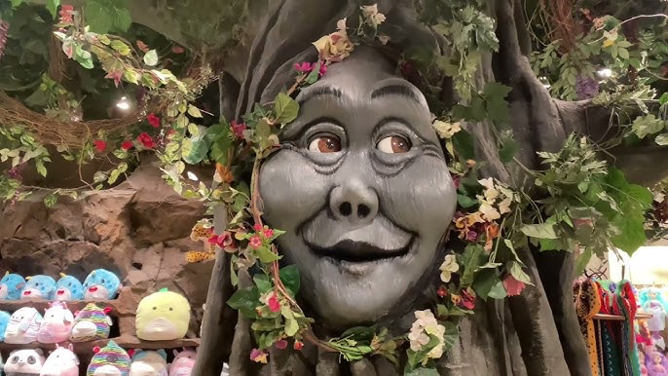
Notes:
Tracy the Talking Tree

Slide 7
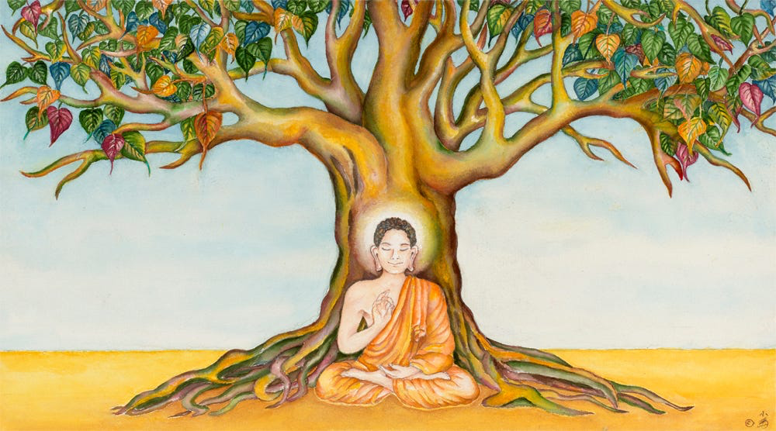
Notes:
Bodhi tree (Enlightenment tree)

Slide 8

Notes:
Tiger Woods

Slide 9
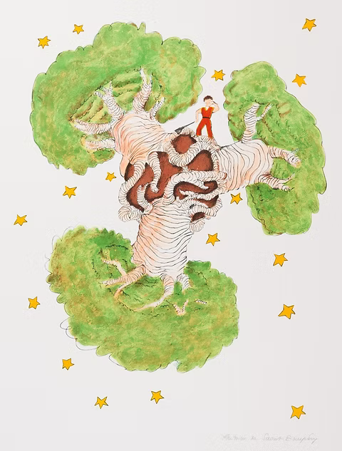
Notes:
Baobab tree

Slide 10
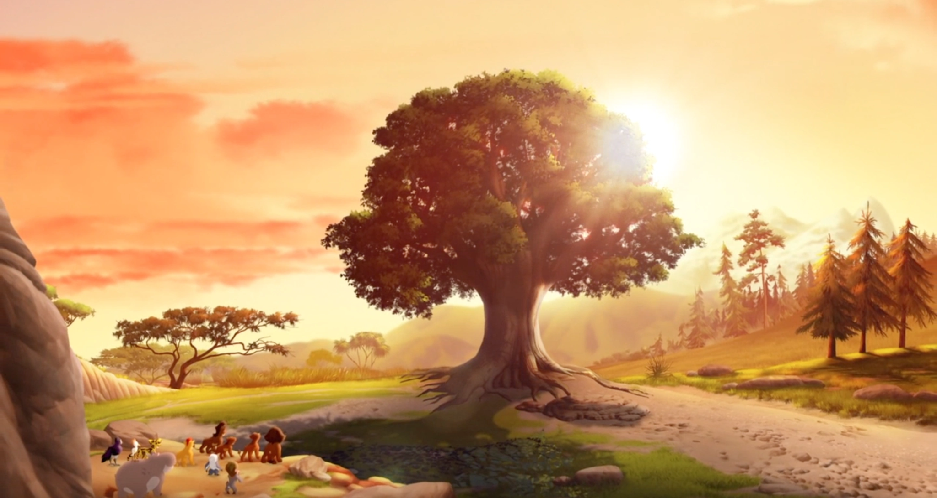
Notes:
Tree of life

Slide 11

Notes:
Timberland

Slide 12
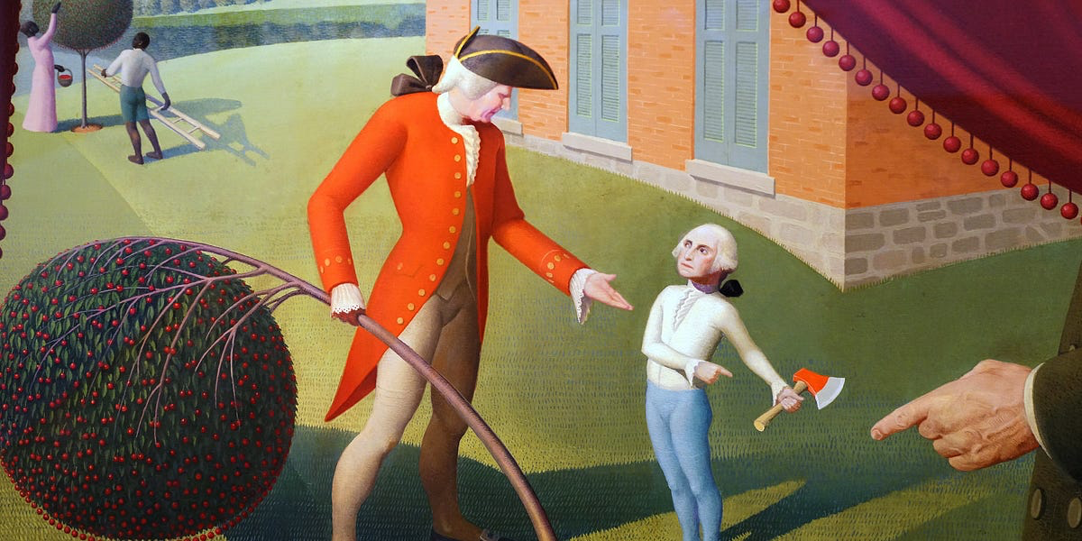
Notes:
George Washington cherry tree

Slide 13
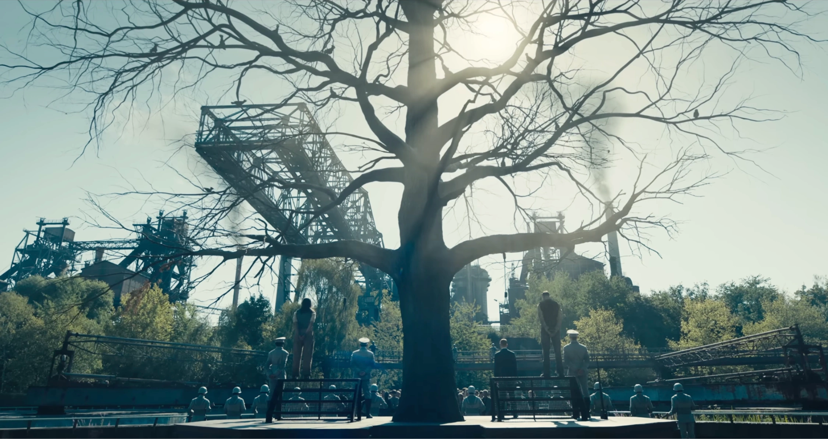
Notes:
Hanging tree

Slide 14
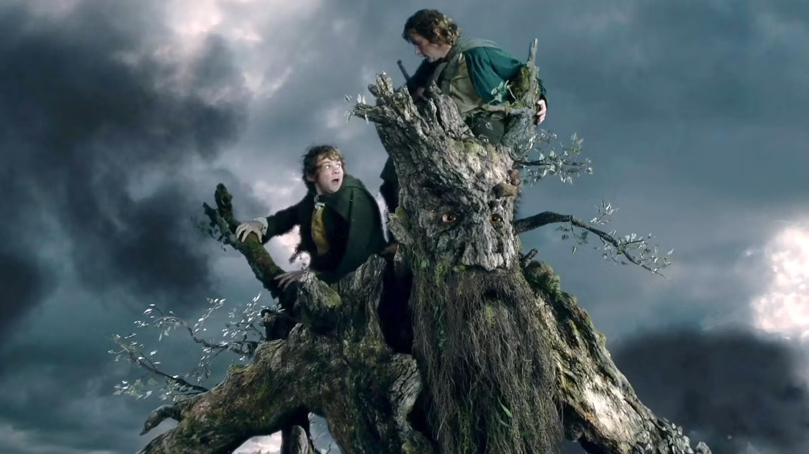
Notes:
Tree beard

Slide 15
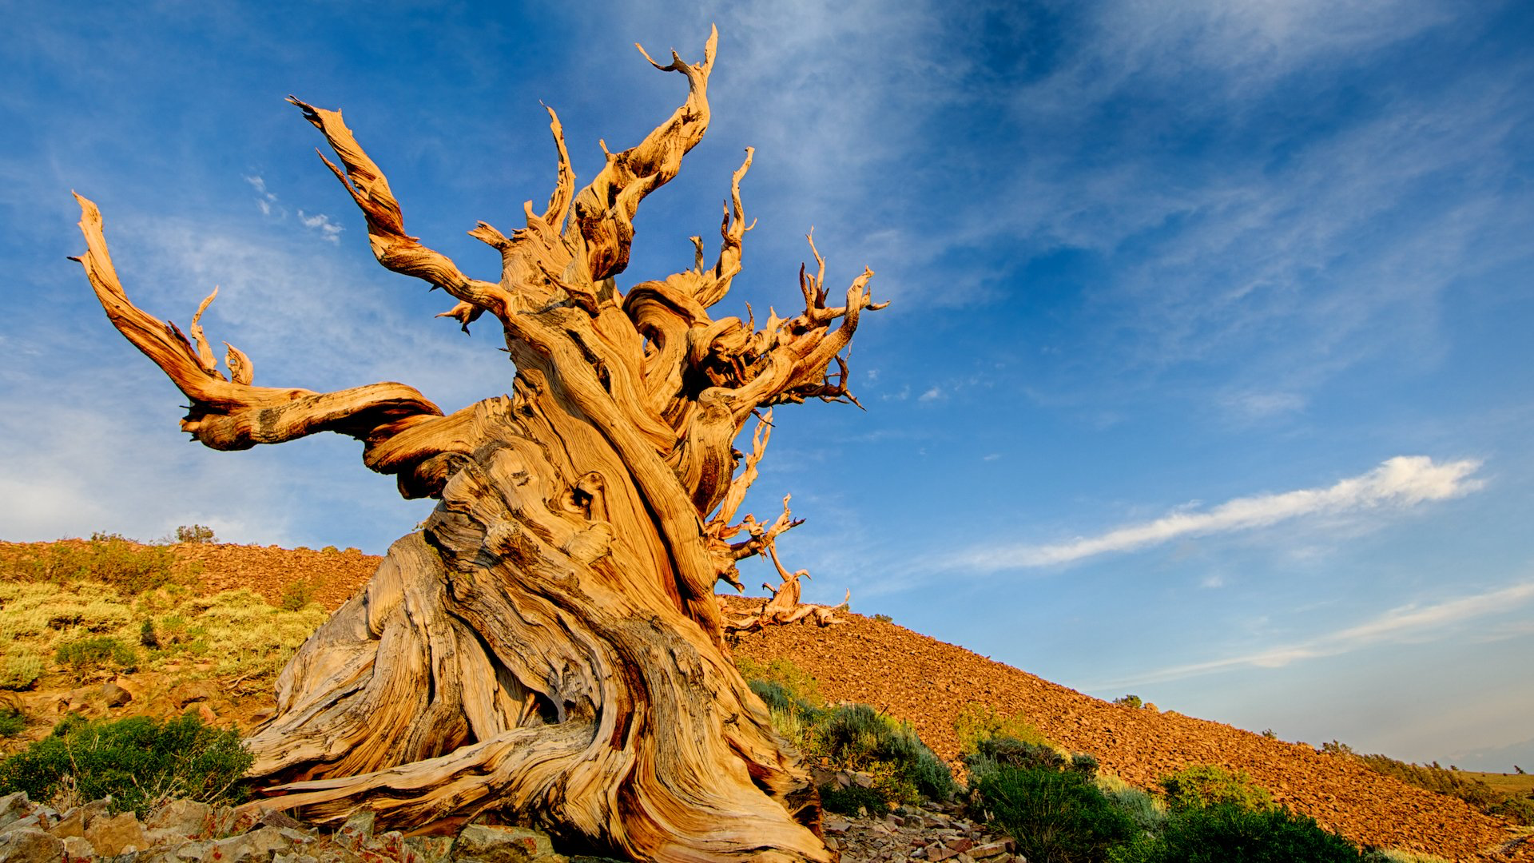
Notes:
Methuselah

Slide 16

Notes:
The White Tree of Gondor

Slide 17
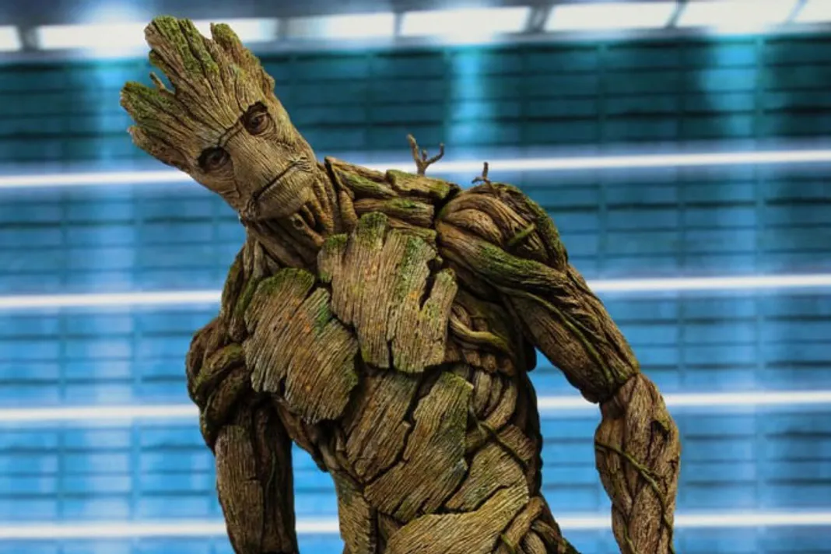
Notes:
Groot

Slide 18
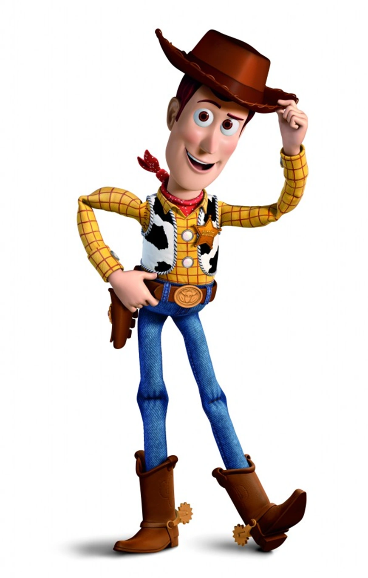
Notes:
Woody

Slide 19

Notes:
Willow

Slide 20
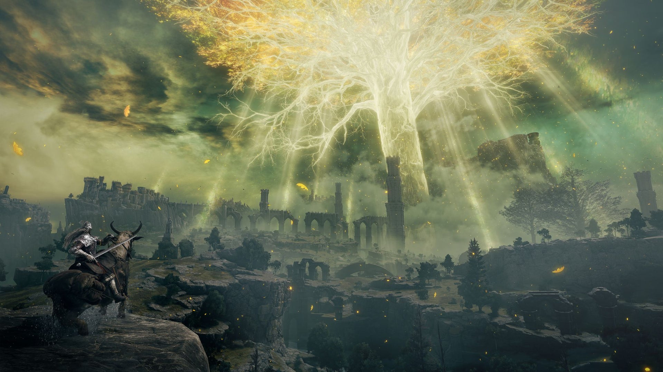
Notes:
The Erdtree

Slide 21
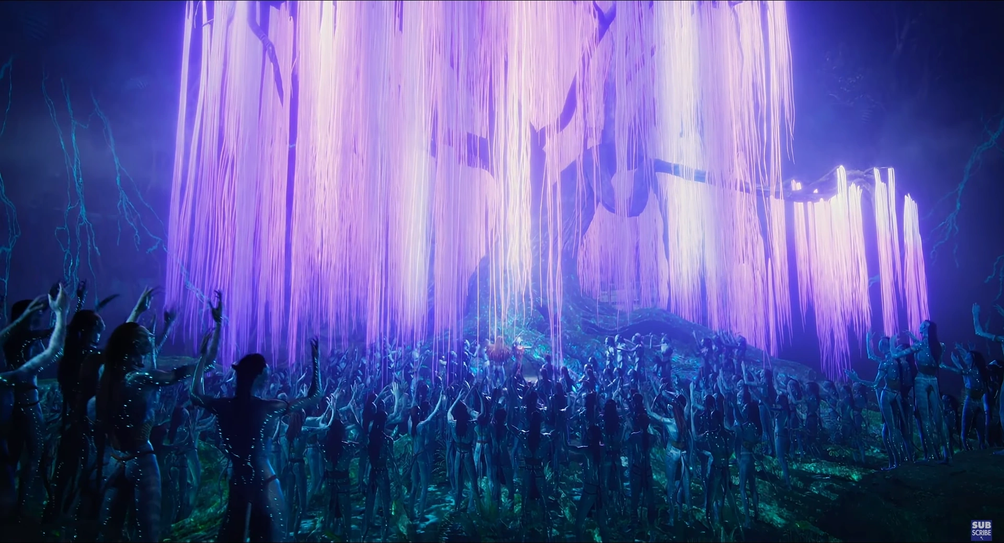
Notes:
The Tree of Souls (Vitraya Ramunong)

Slide 22
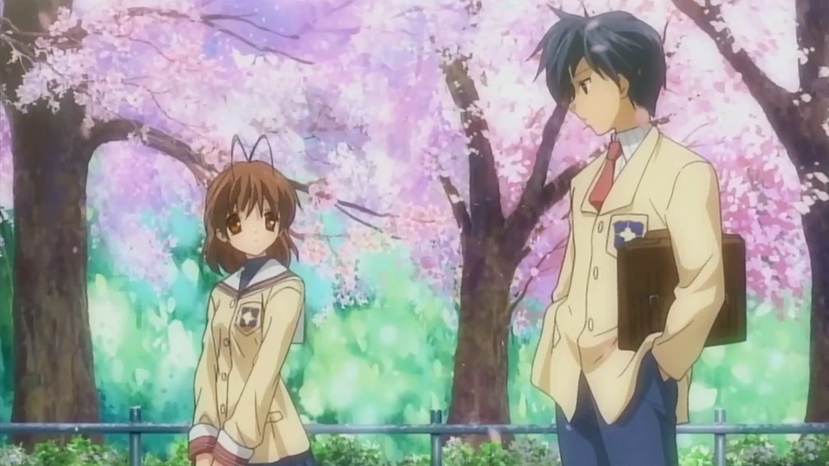
Notes:
Cherry blossoms

Slide 23
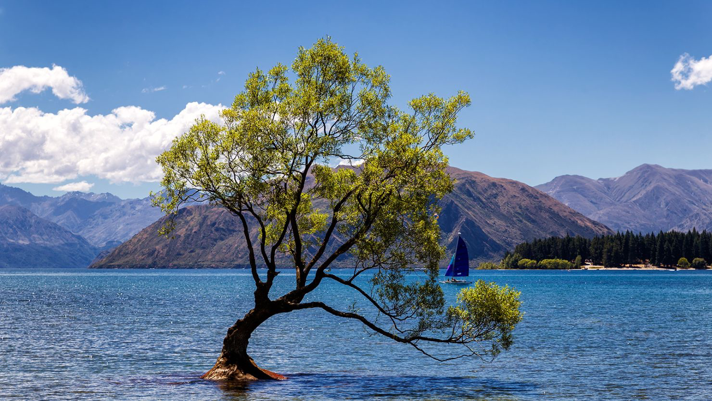
Notes:
Wanaka tree

Slide 24
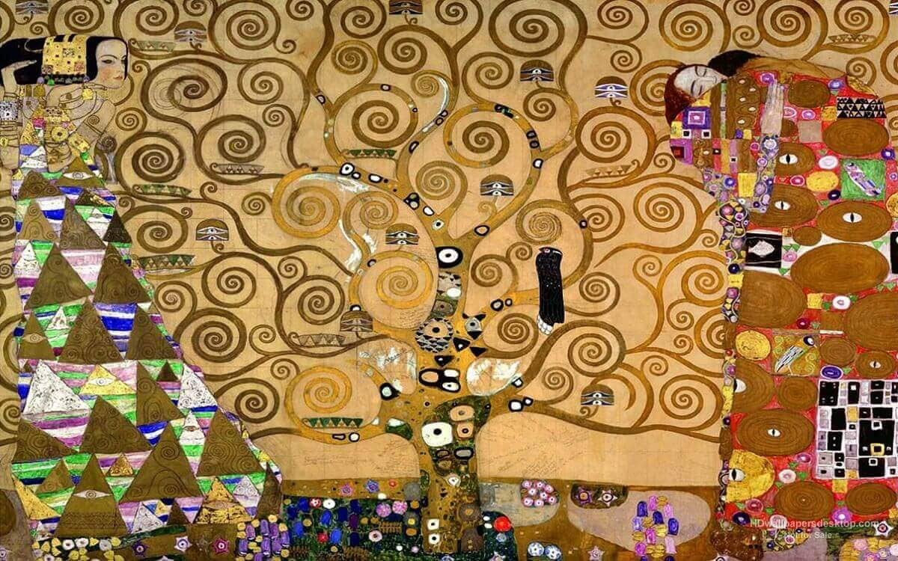
Notes:
The tree of life (Klimt)

Slide 25
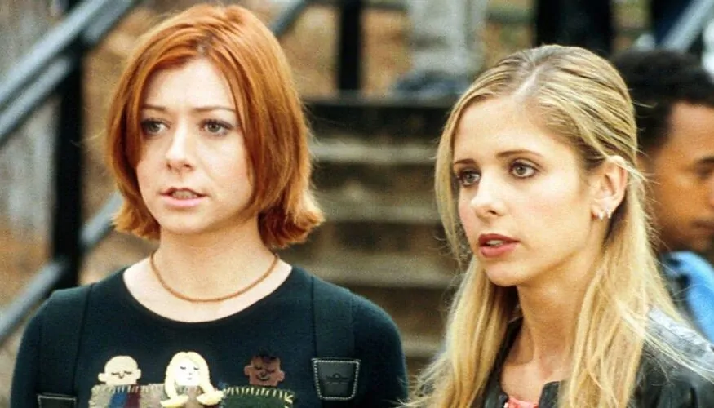
Notes:
Willow

Slide 26
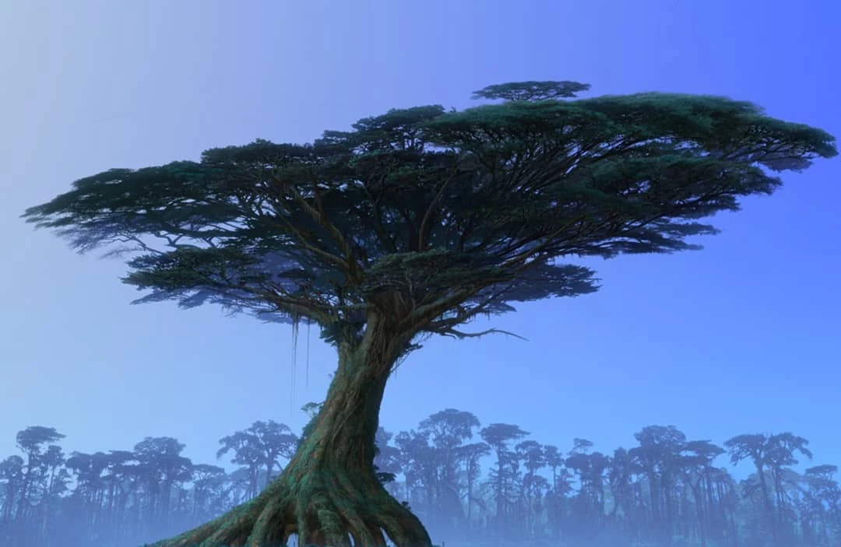
Notes:
Home tree avatar

Slide 27
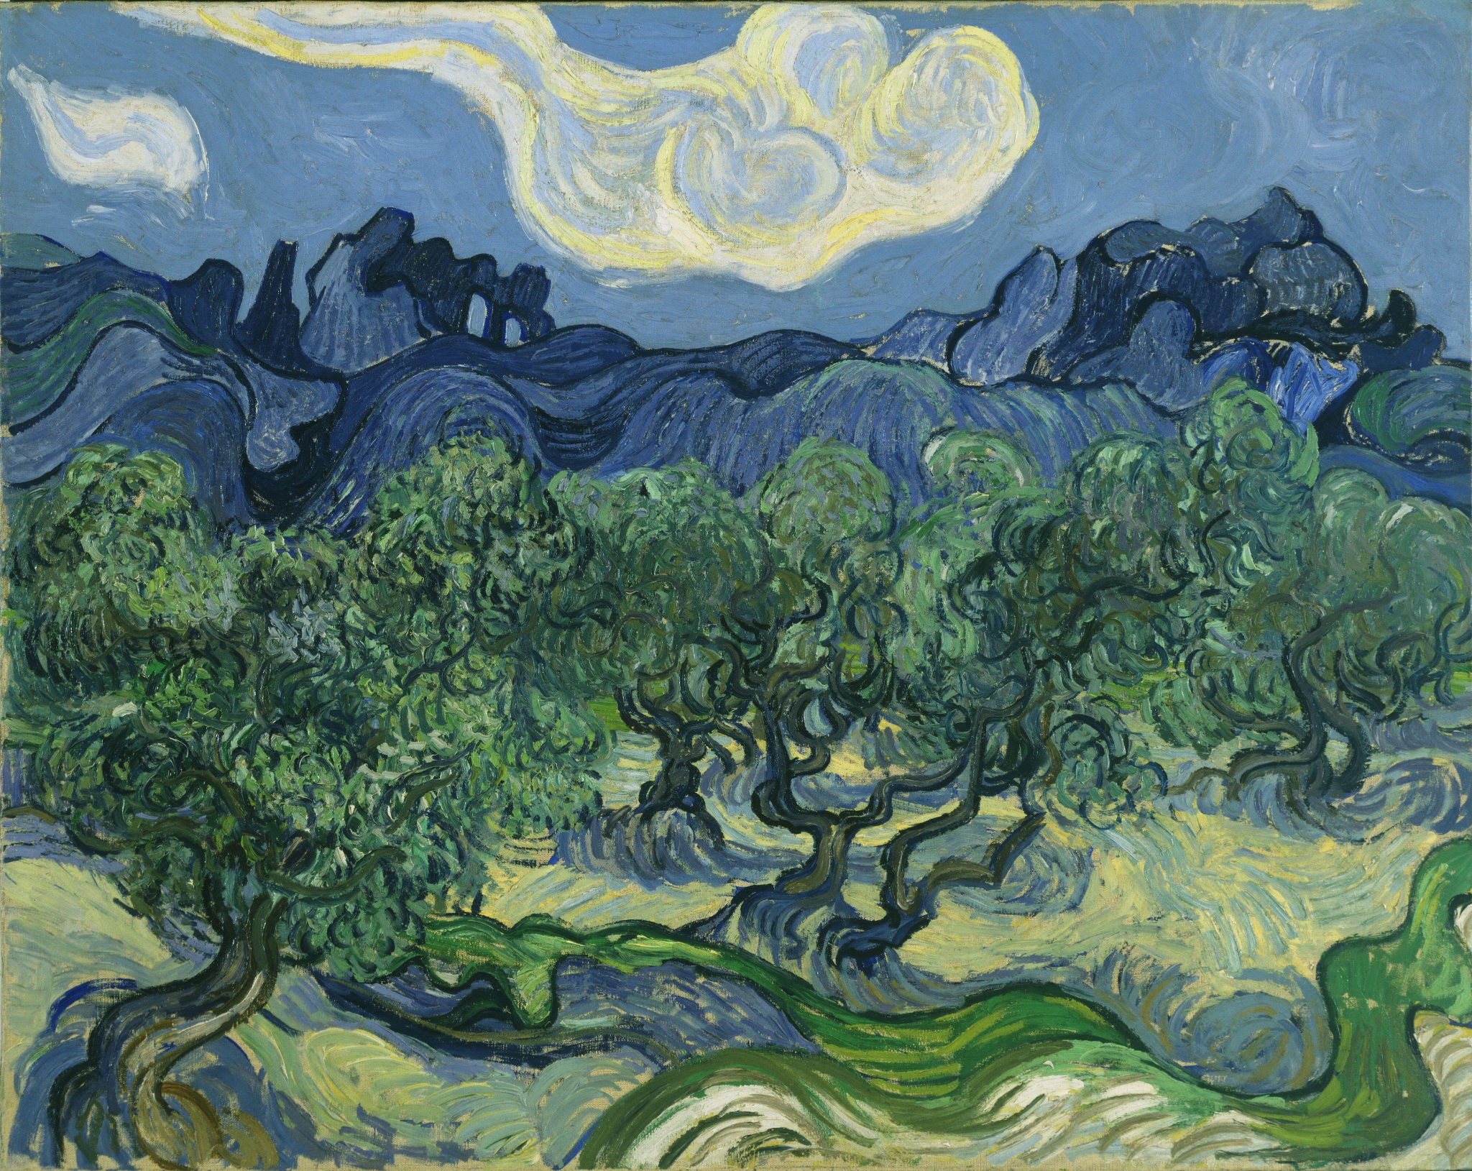
Notes:
Olive trees

Slide 28
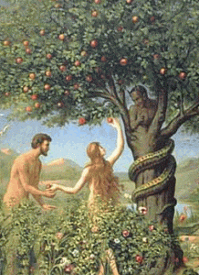
Notes:
Tree of knowledge

Slide 29
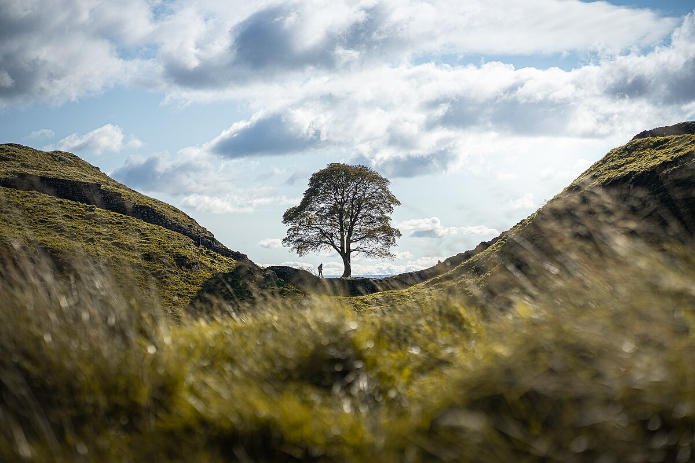
Notes:
Sycamore Gap Tree

Slide 30
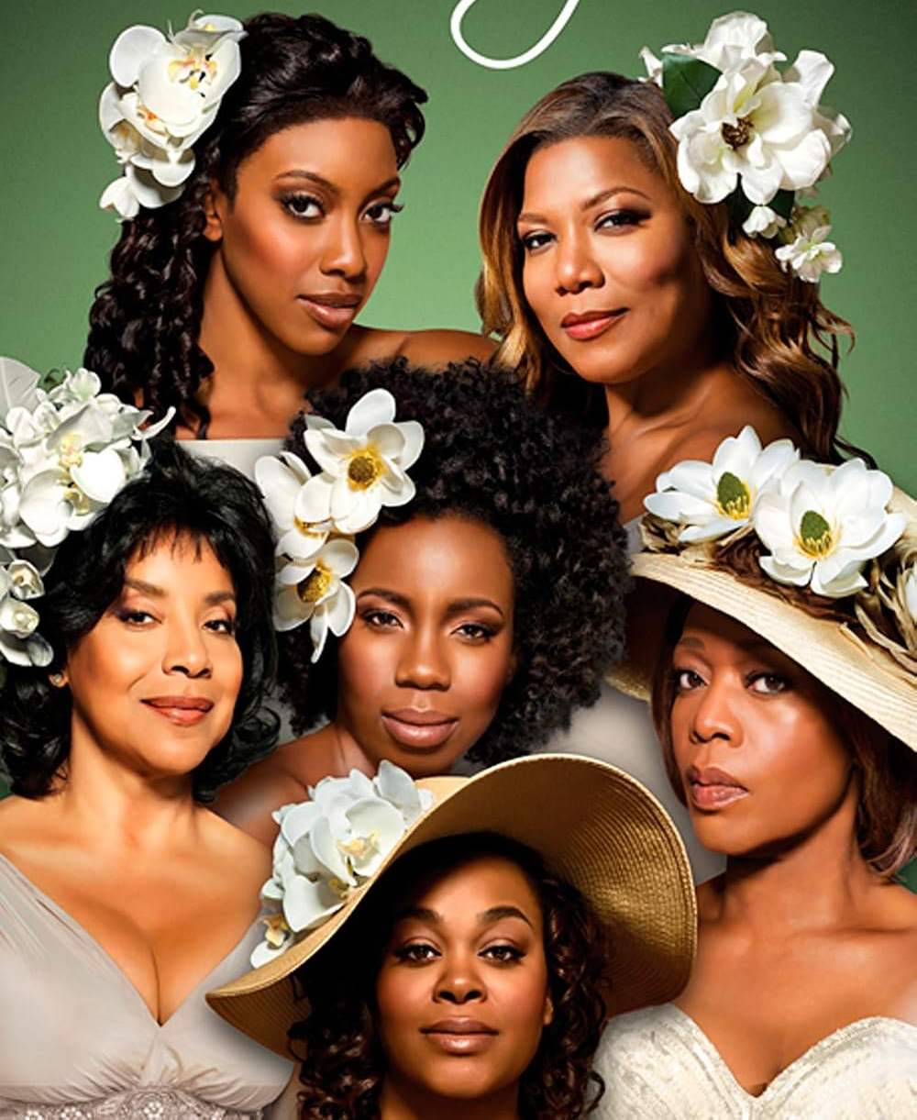
Notes:
(Steel) Magnolias

Slide 31
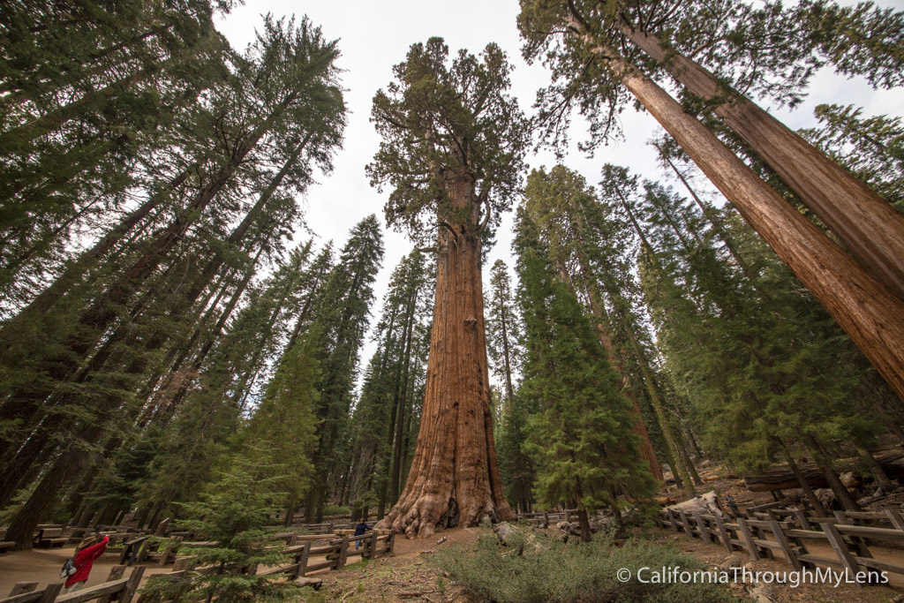
Notes:
General Sherman Tree

Slide 32

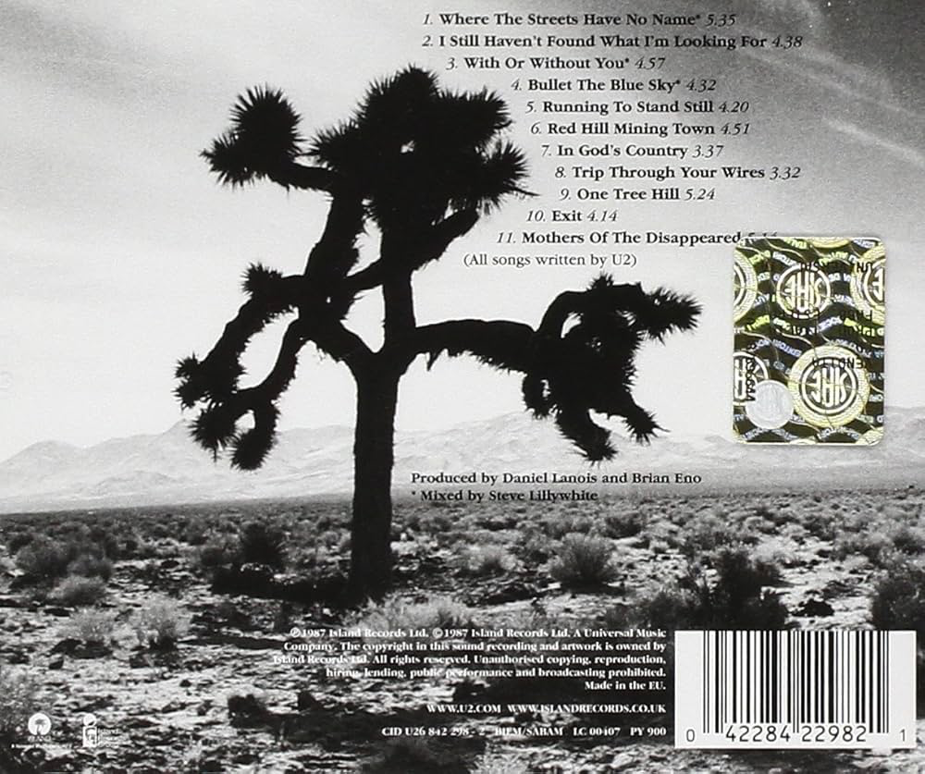
Notes:
The Joshua Tree

Slide 33
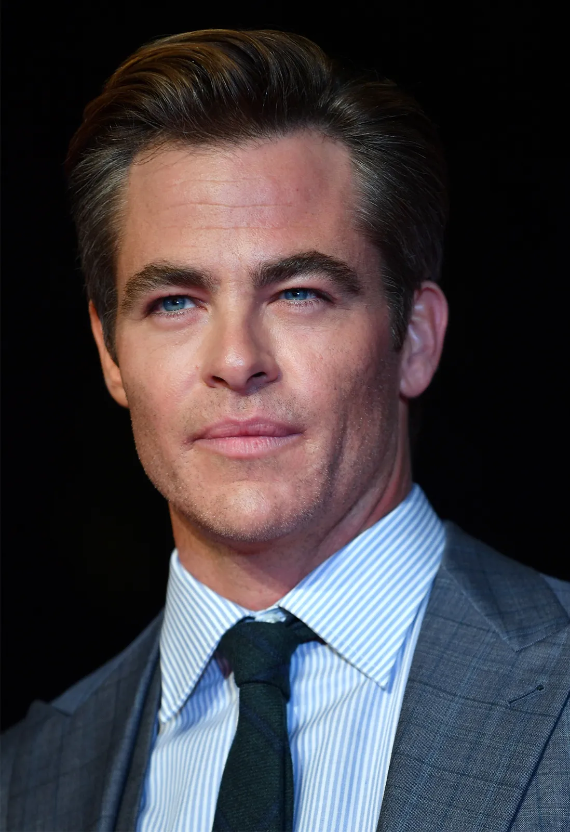
Notes:
Chris Pine

Slide 34
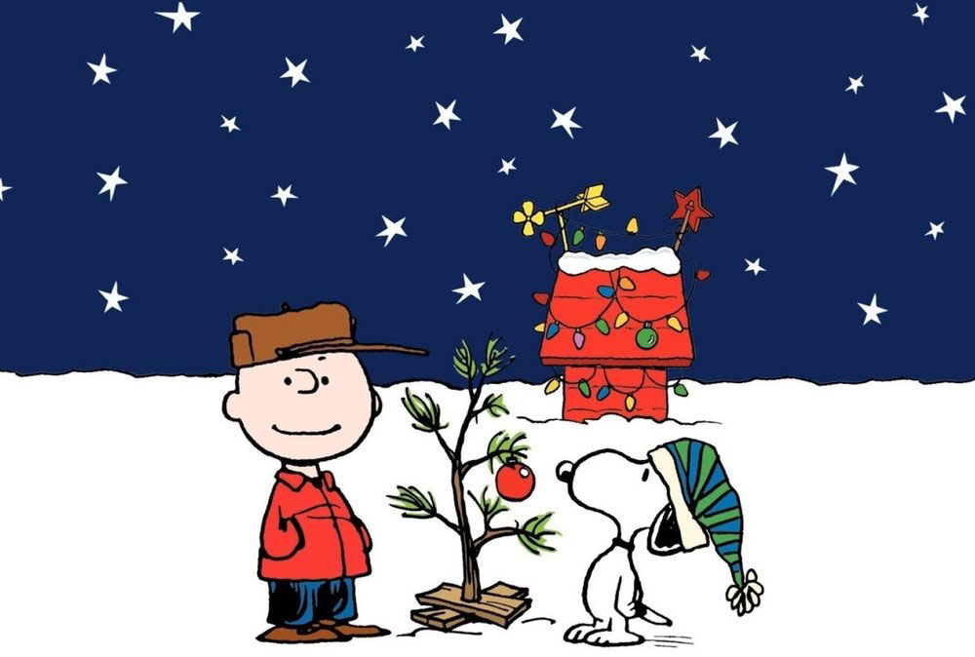
Notes:
Charlie Brown Christmas tree

Slide 35

Notes:
Willow (Smith)

Slide 36
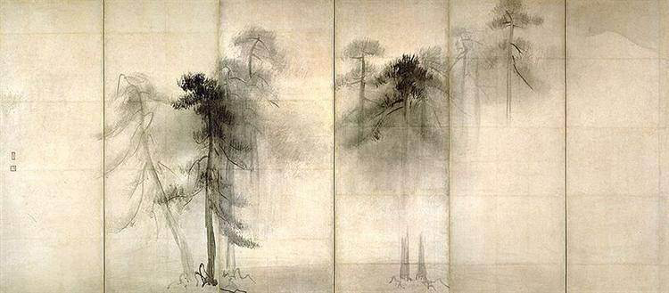
Notes:
Pine trees (Tohaku)

Slide 37
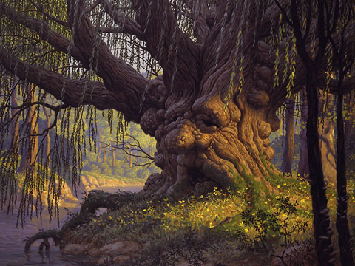
Notes:
Old man willow

Slide 38
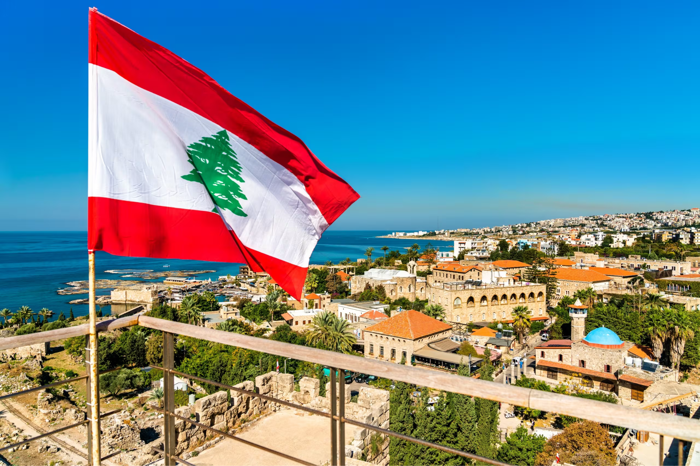
Notes:
Lebanon

Slide 39
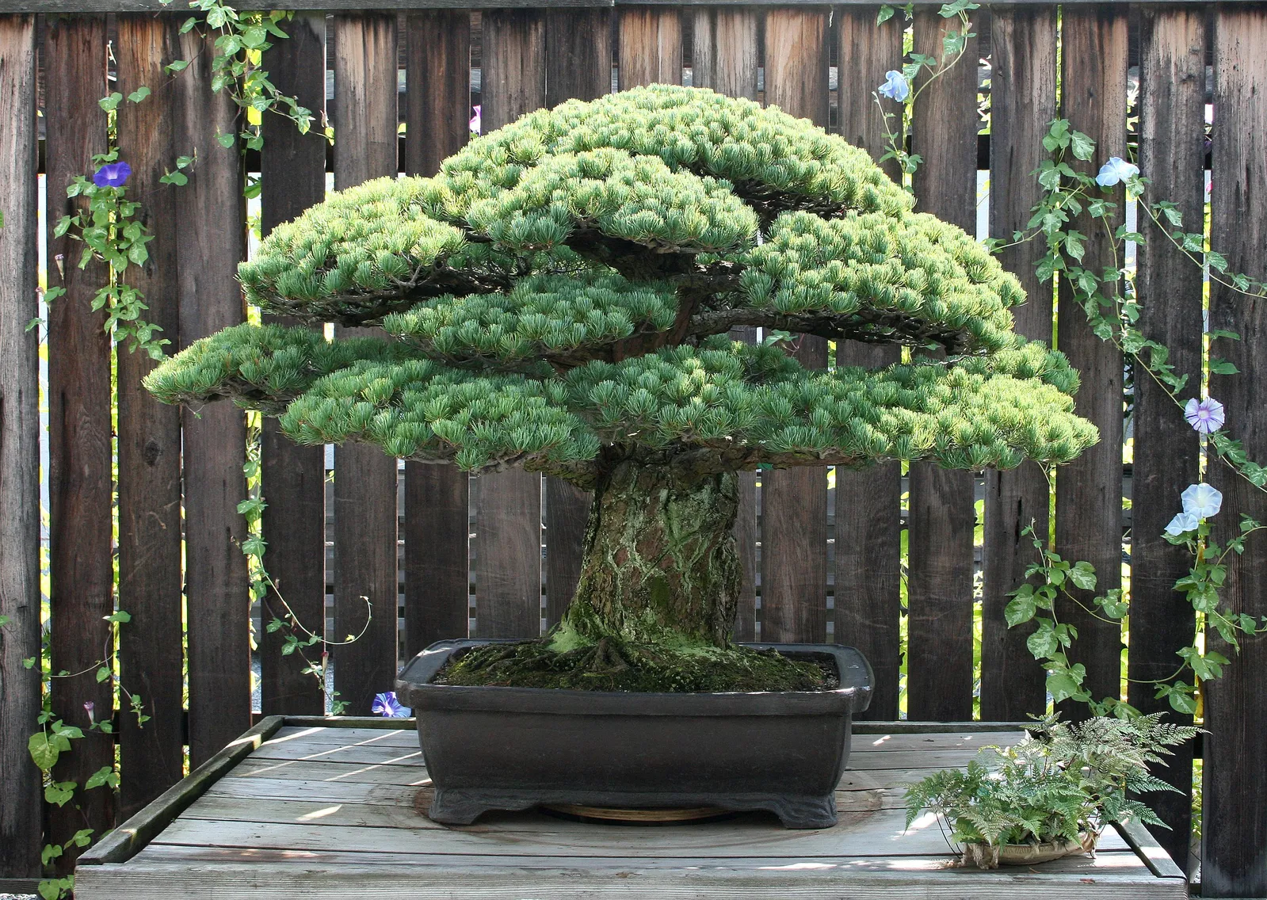
Notes:
Bonsai tree

Slide 40
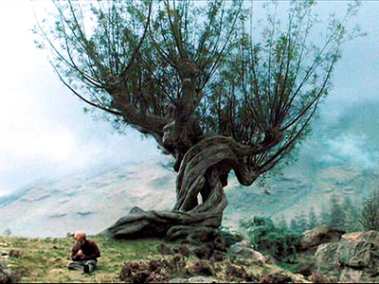
Notes:
The whomping willow

Slide 41
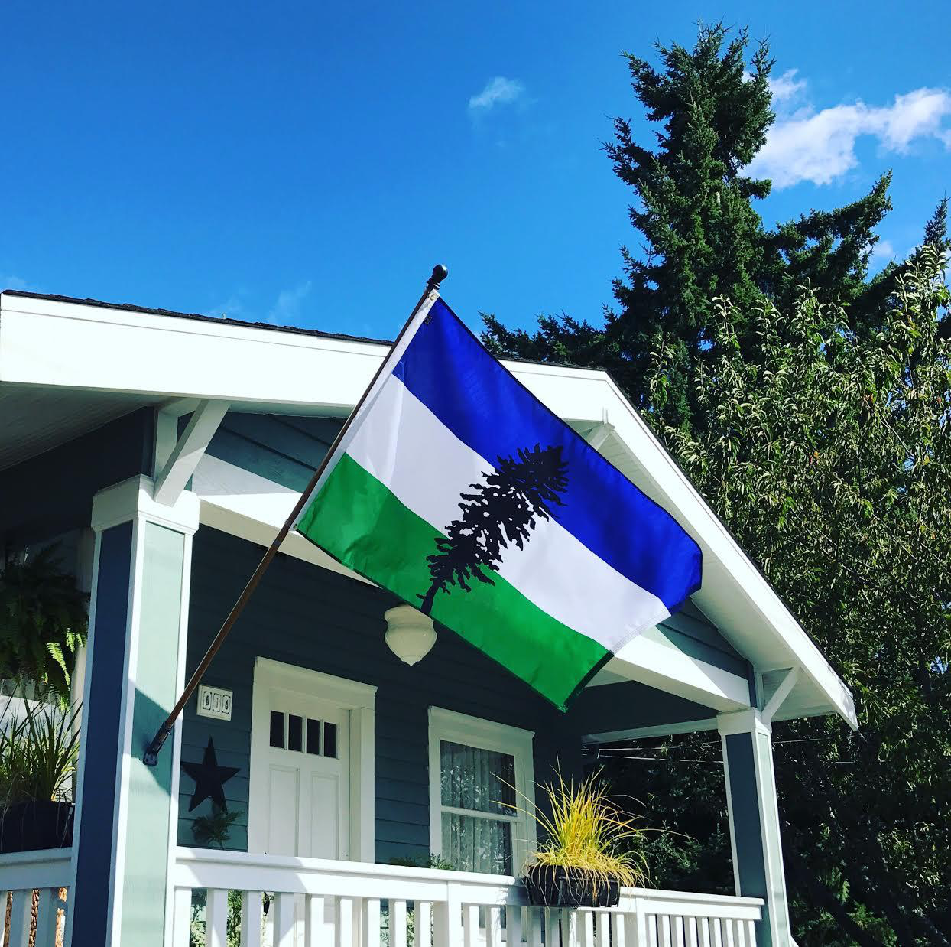
Notes:
Cascadia

Slide 42
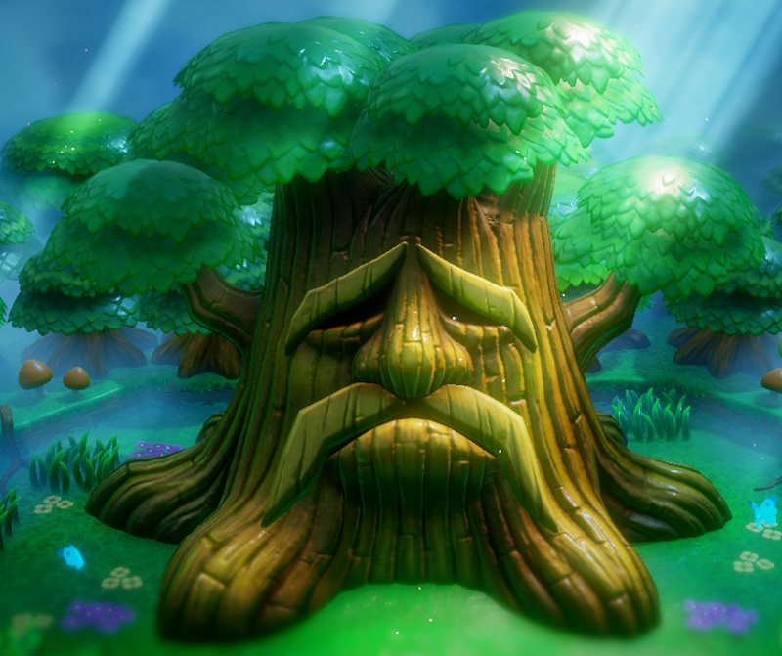
Notes:
Deku tree

Slide 43

Notes:
REI

Slide 44
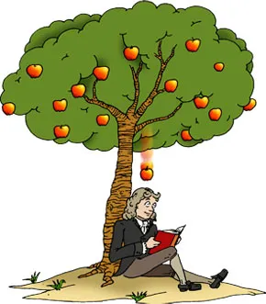
Notes:
Apple tree (Isaac Newton)

Slide 45

Notes:
Professor elm

Slide 46
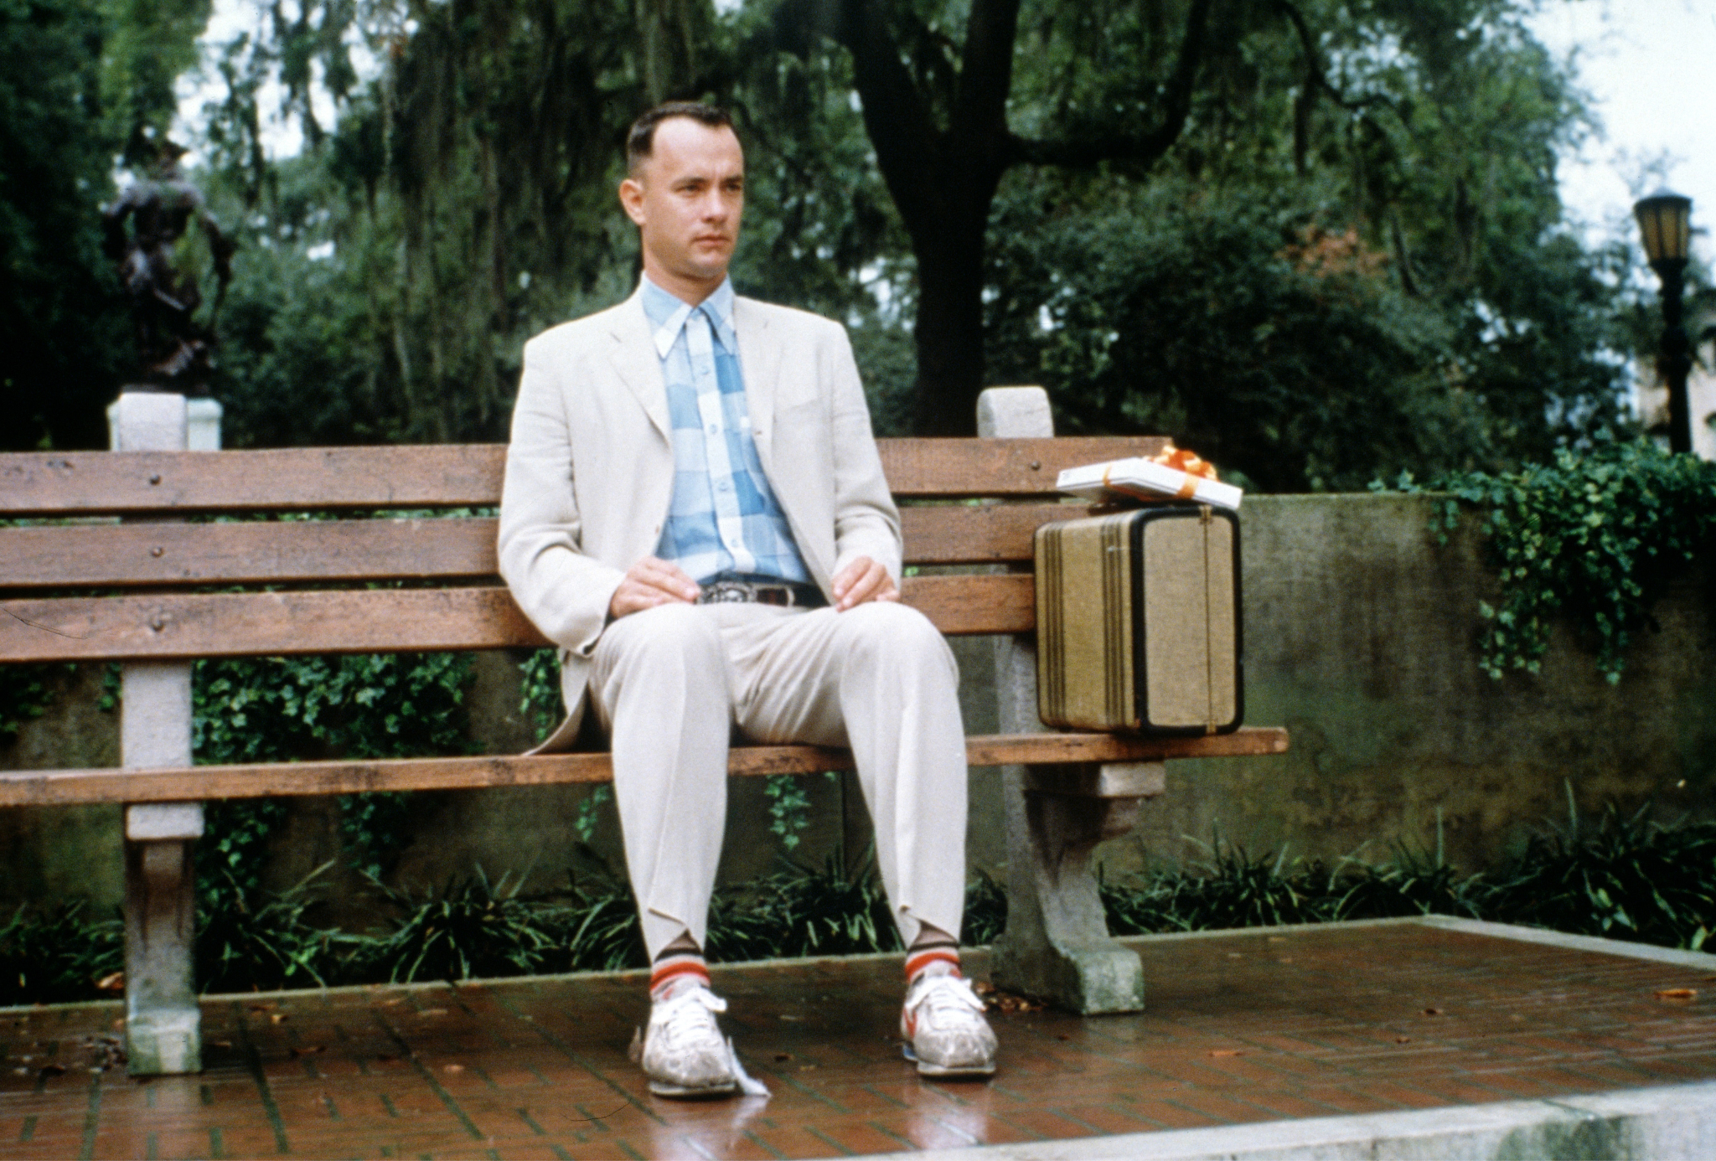
Notes:
Forrest Gump

Slide 47

Notes:
The giving tree

Slide 48
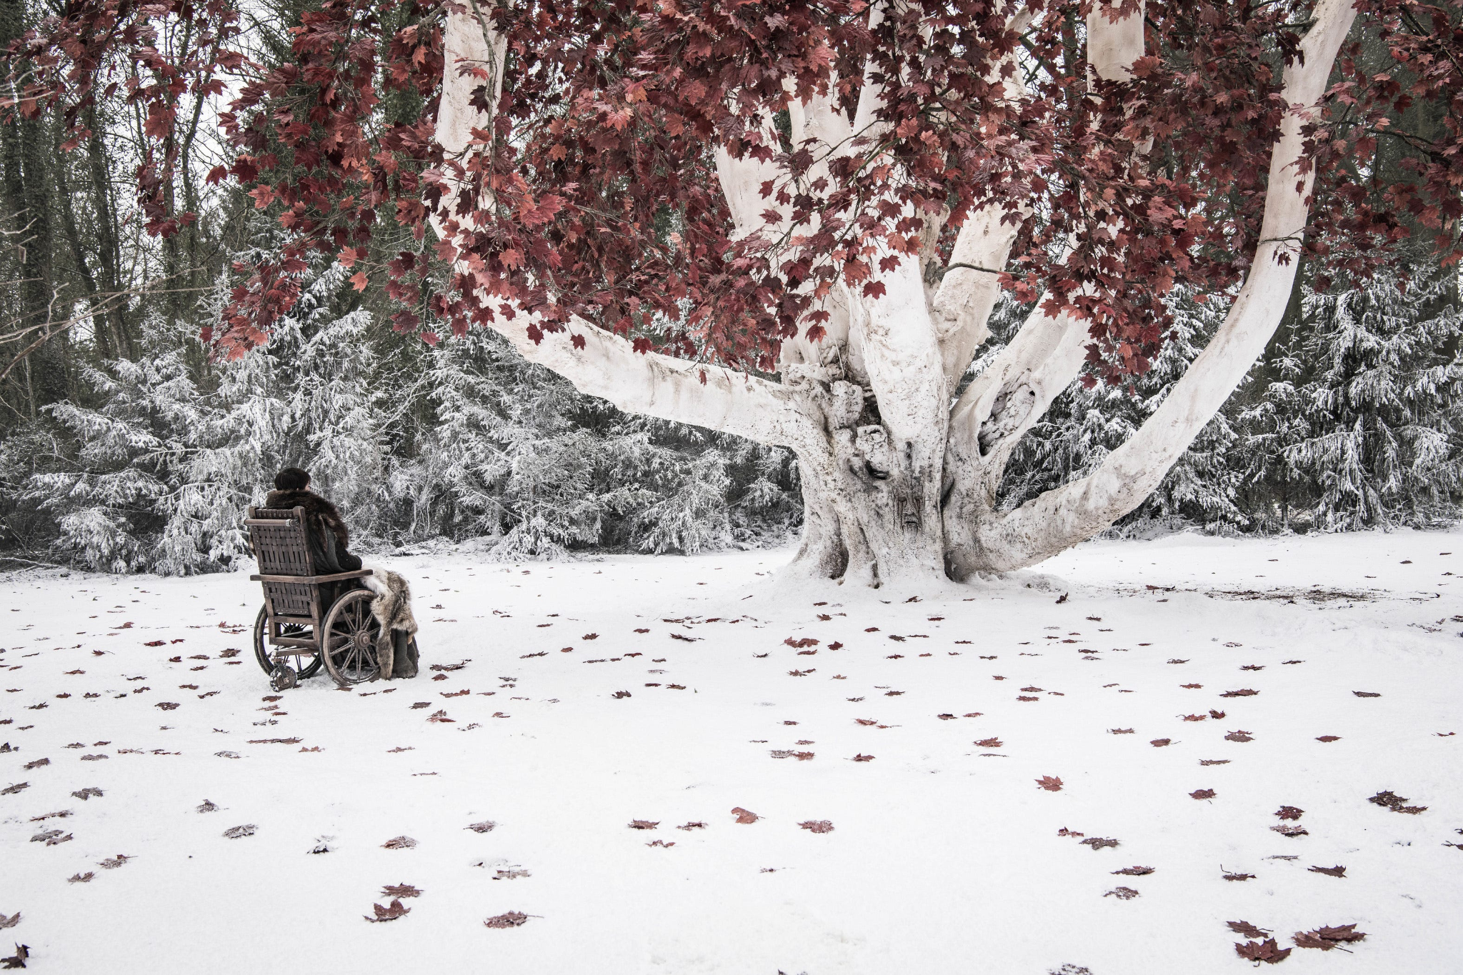
Notes:
Weirwood tree

Slide 49
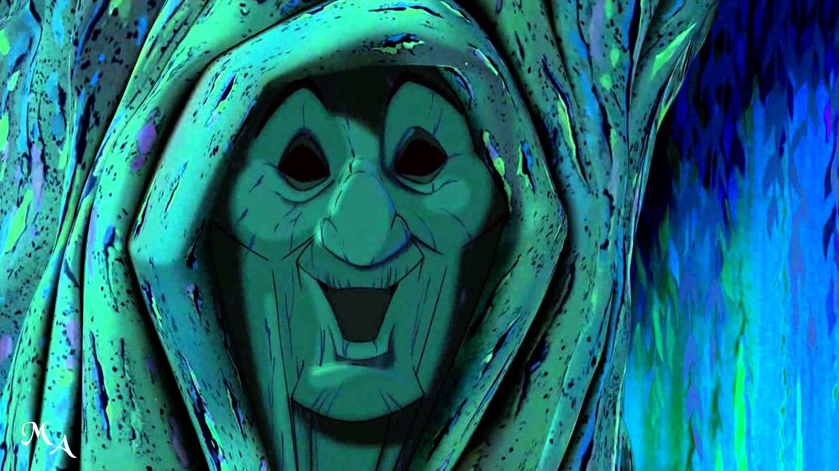
Notes:
Grandmother willow

Slide 50
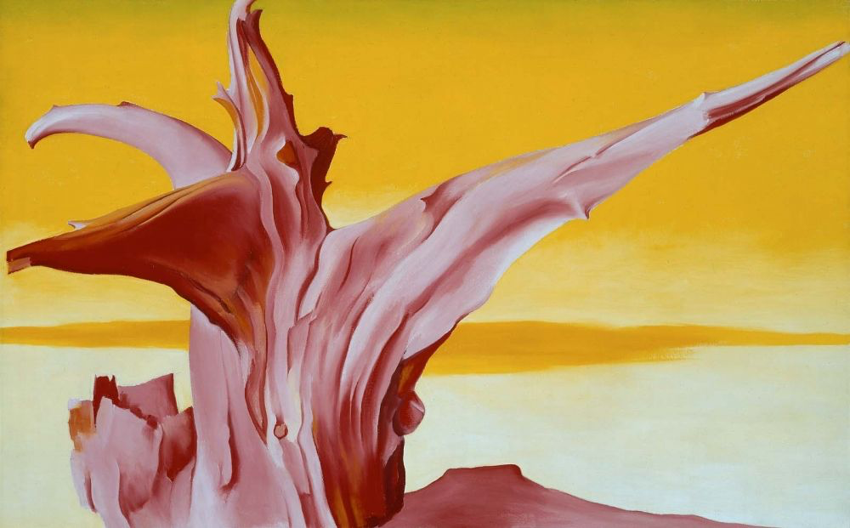
Notes:
Red tree (O’keefe)

